Slide 1

Hotel management system

Slide 2
Services
Customer Module
Rooms Module
Inventory Module
Notification Module
Billing Module

Slide 3
INVENTORY Module
Inventory Microservice provides information about the items available, and it gives the information about the selected item like the name of the item , quantity and timestamp.
It provides different methods for admin while ensuring proper validation and business logic.
It connects with the Notification Module through feign client to get the information about the customer who used the booking service. inventory-related notifications, such as low stock alerts, item restocking updates, and inventory change confirmations.

Slide 4
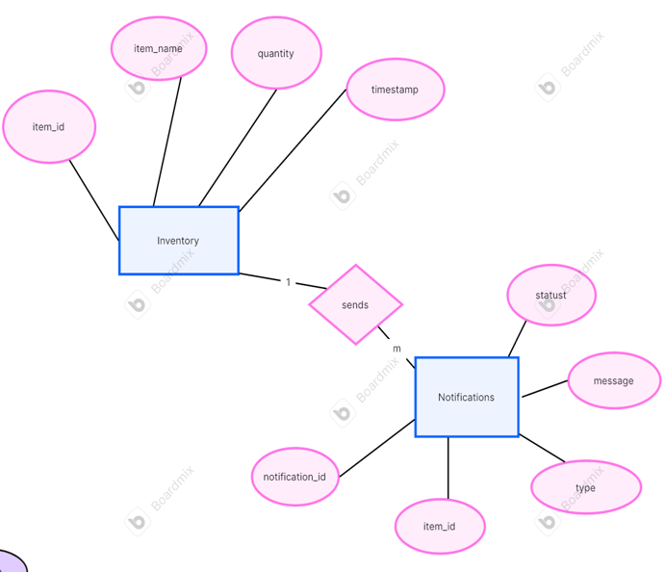
ENTITY RELATION DIAGRAM

Slide 5
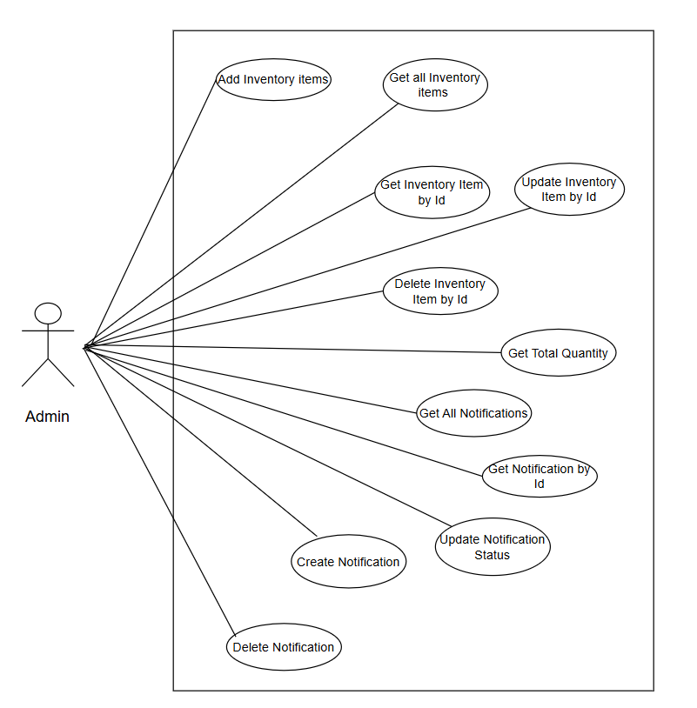
USE CASE dIAGRAM

Slide 6
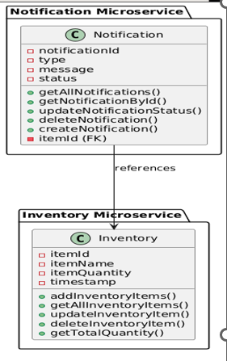
CLASS DIAGRAM

Slide 7
THANK YOU

